Slide 1
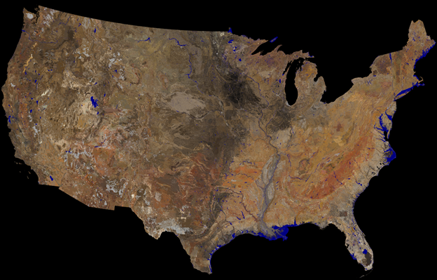
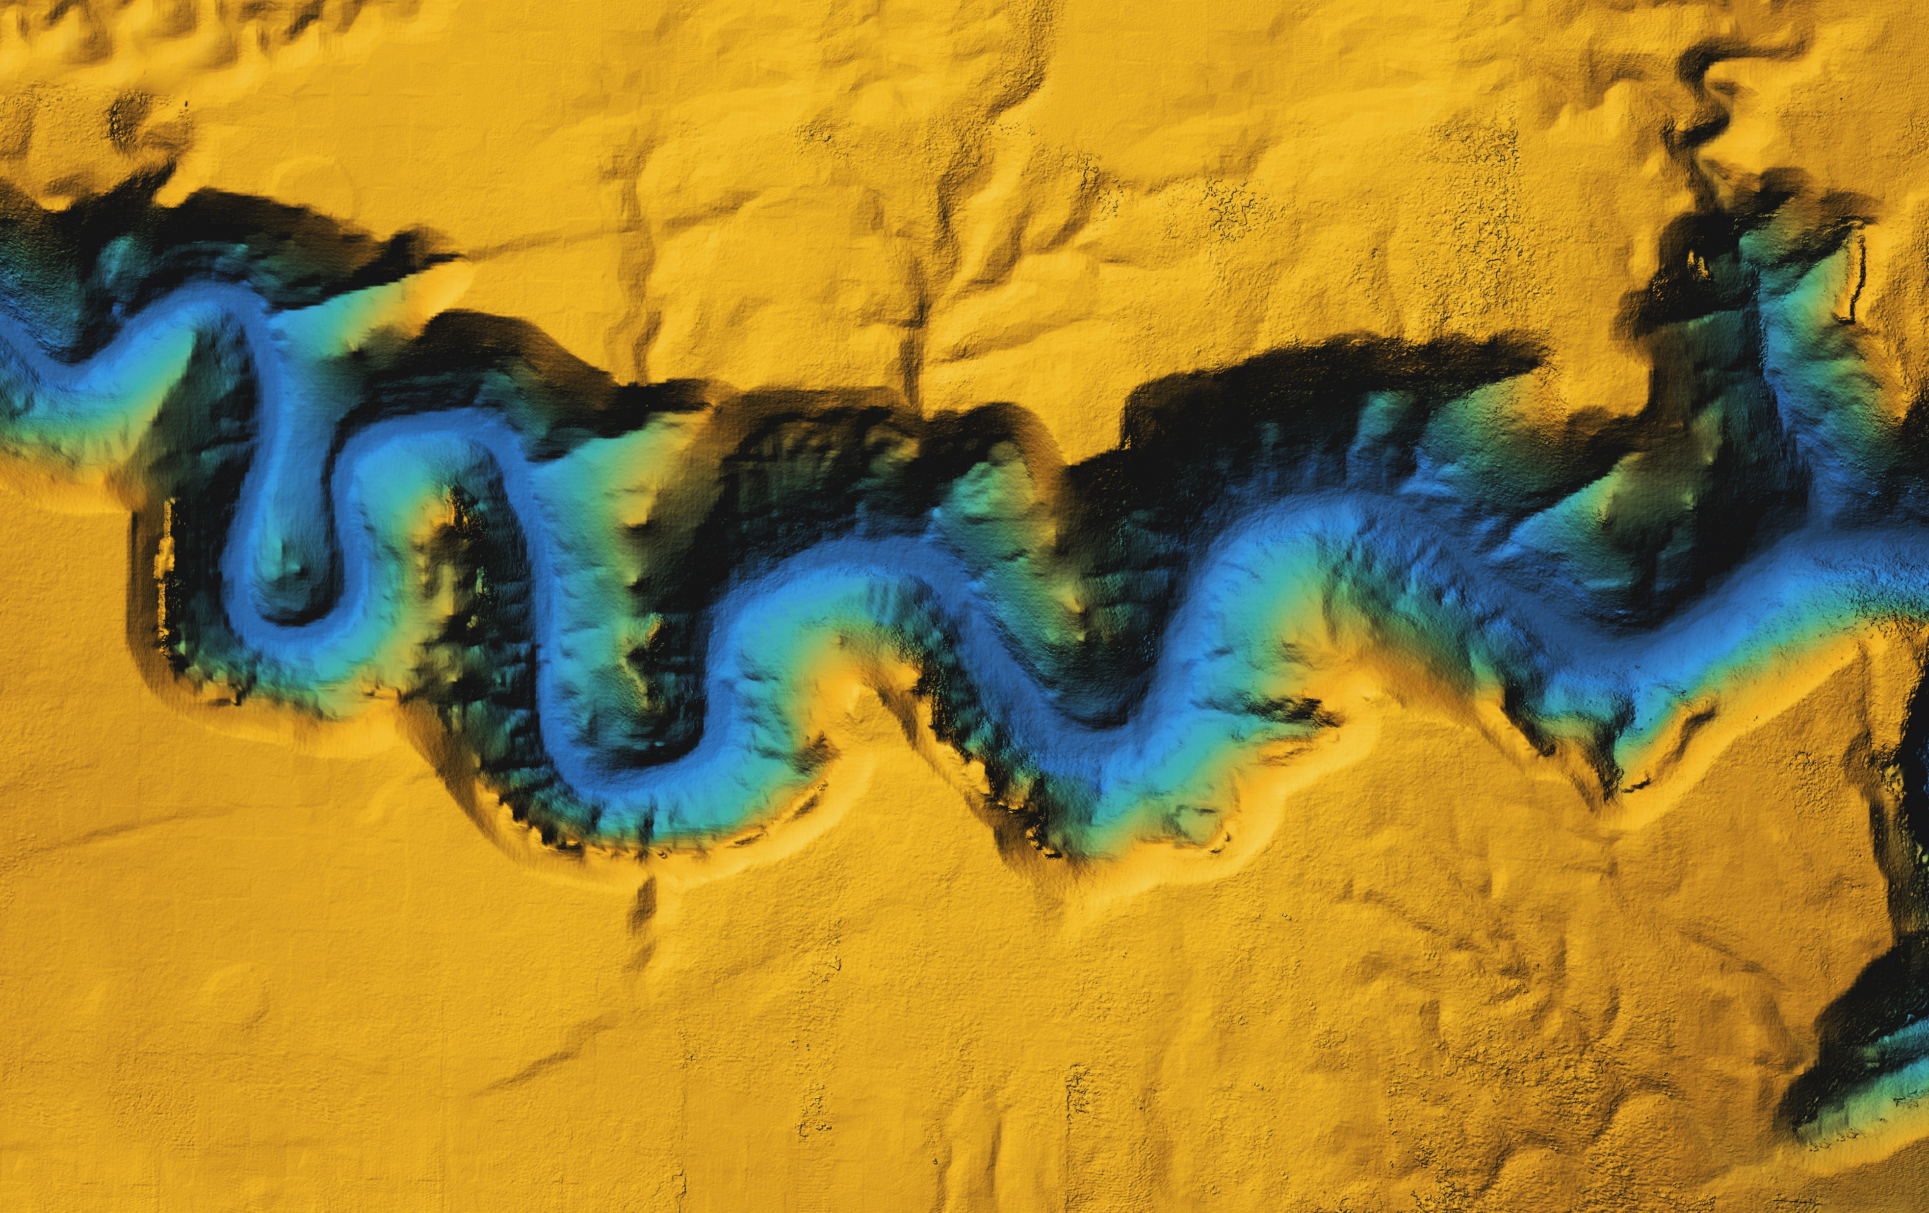
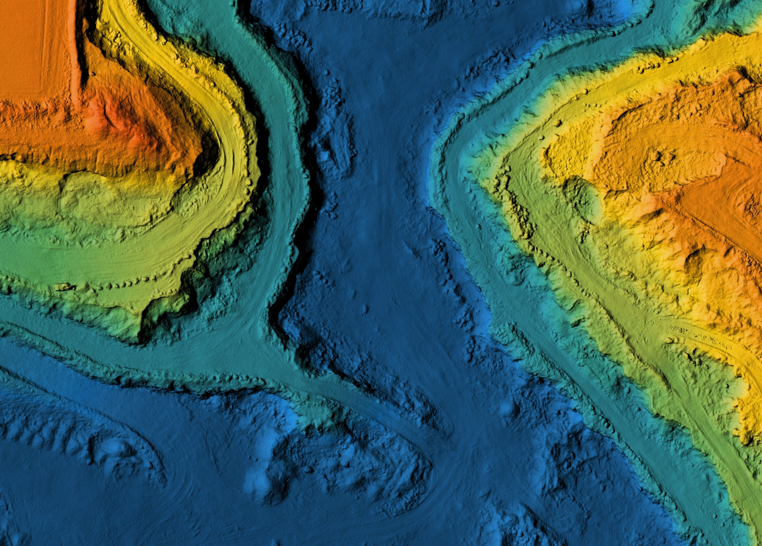
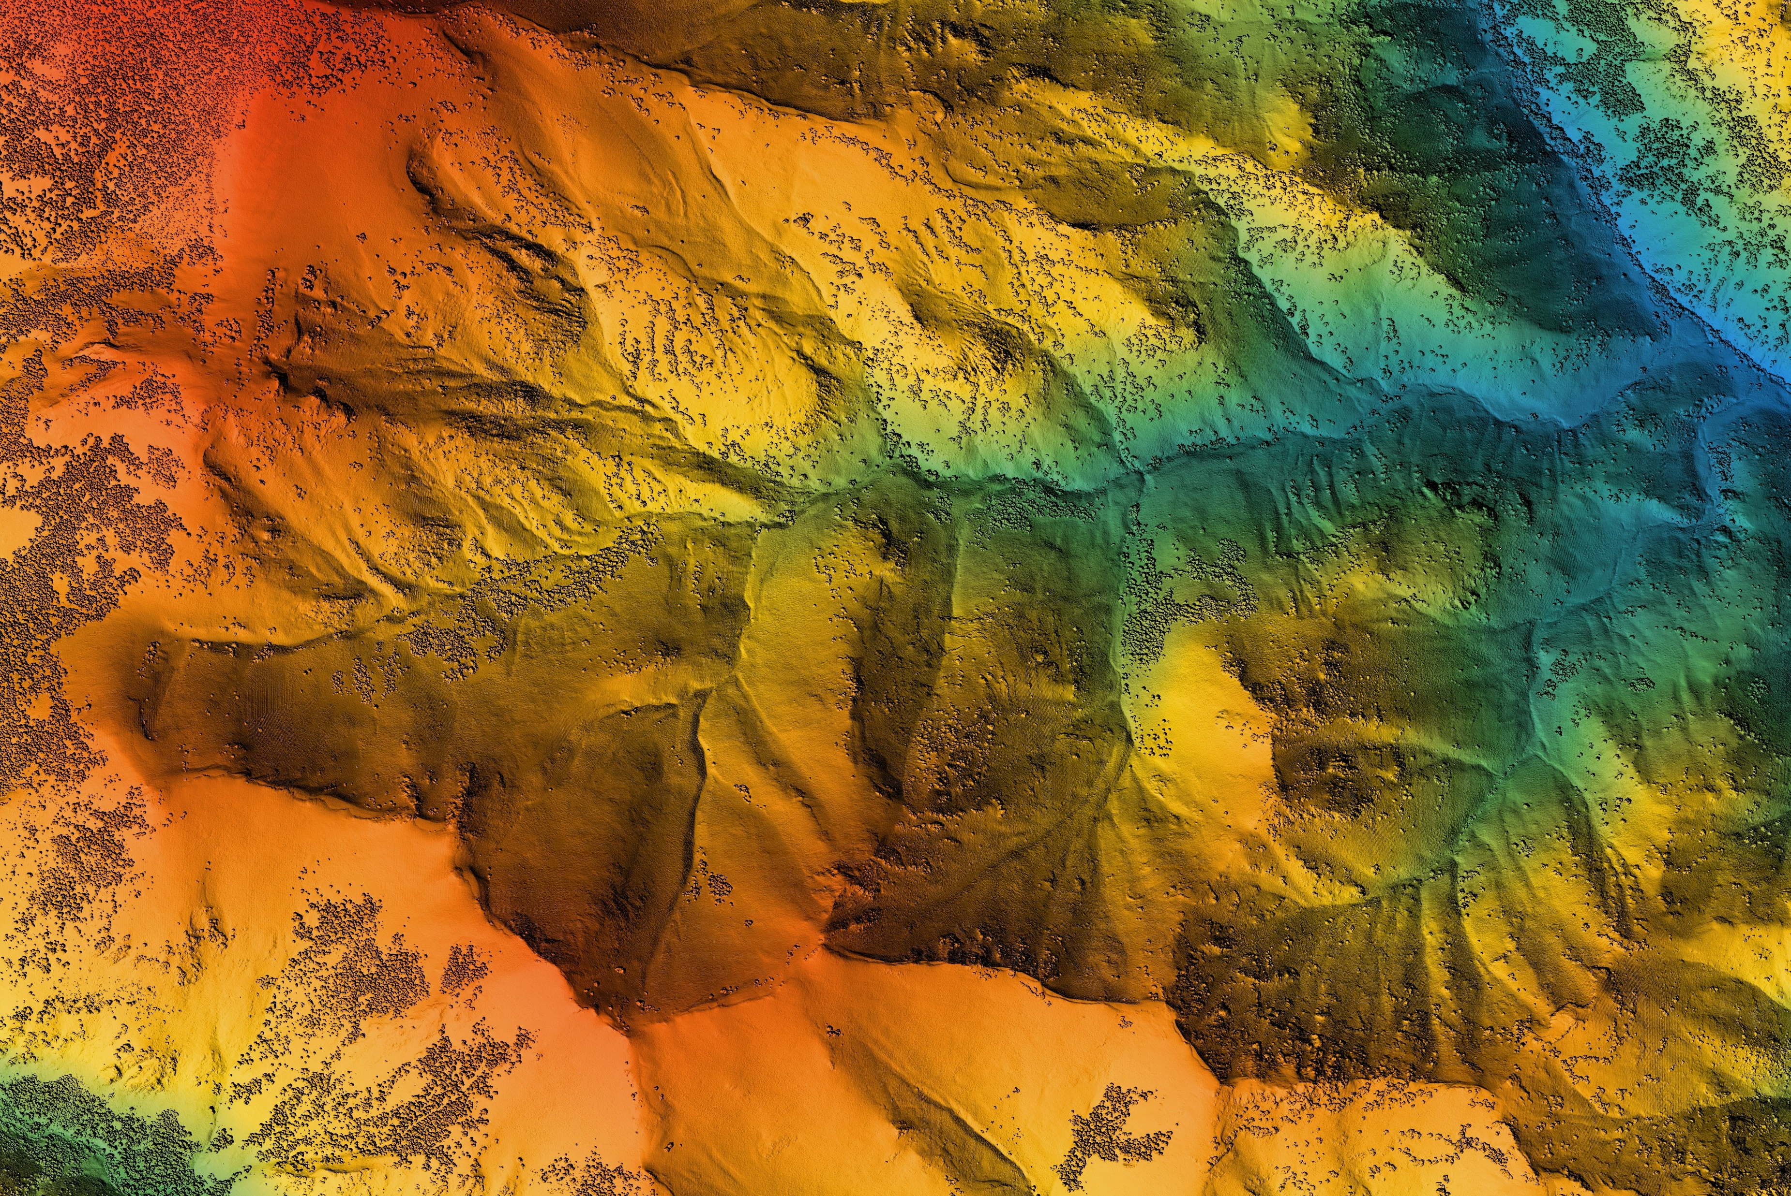
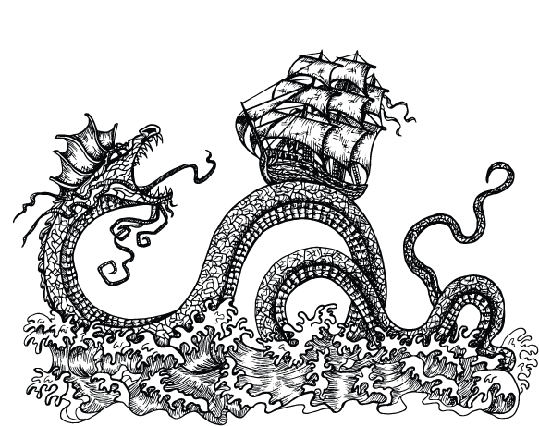
Modeling DATA
February 16, 2023
Notes:
Hi for those that don’t know me my name is Jason Nemecek, National Soil Data Applications Scientist. One of my roles is to help get more soil data that Kyle just described; interconnected with CD and CART.
I have worked with the CD/CART teams for years as the key point of contact and representative for SPSD. My role is the National Technical Soil Leader for Conservation. I am responsible for providing national leadership, technical expertise, and coordination in the area of national soils information and application development. I Provided national technical and program oversight and leadership in the application and integration of new technology for the development and deployment of soil information applications and products.

Slide 2
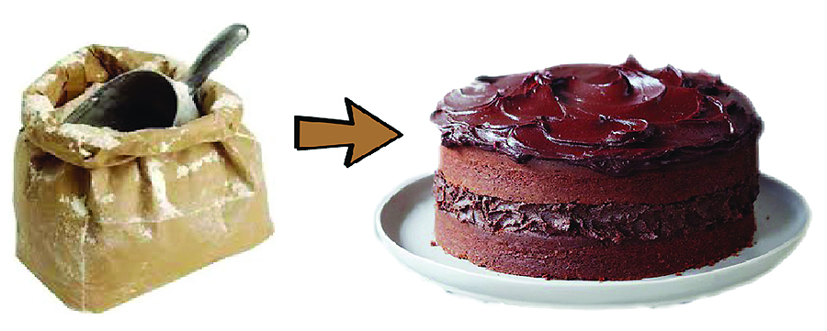
Building a Cake
A practical example of flour (like official soils data), as an important ingredient to a cake (like interpretations).
Notes:
Building a model is like building a cake.
Let’s imagine you’re setting up a bakery specializing in making cakes. The fresh flour represents official soils data (one important ingredient); the finished cakes represent soil interpretations or model. If the cake turns out tasting poorly, you wouldn’t change the fresh flour, you’d first look at changing the overall recipe instead. The fresh flour is the raw material, or base that holds the cake together; one important ingredient of the recipe. Similarly, current official soils data is the base ingredient to making a good, solid interpretation. If you are developing interpretations, one thing to keep in mind is your model might not turn out as desired the first time. You might need to modify the model several times to get desired results and calibrate it from actual data. The fresh flour (or official soils data) is all-purpose, having many uses for different interpretations and fields. Using fresh flour, or the most updated, official soils data correctly, makes a big difference in the quality of your baking creation or soils interpretation. Like all models require ground truthing.

Slide 3
Modeling Data
Visualization
Being able to answer a question on the fly with confidence
Decision
Processed
Developing the model from the collaboration, good derivatives with good metadata, and raw data
Developing
Context
Collaborating with decision-makers to understand the questions and decisions to build the right model
Knowledge
Meaning
Derivatives of raw data – collecting and developing metadata
Information
Raw
Deep understanding of the structure and content of the raw data (the flour)
Data
Data collection, standards, data handling, tools and platform that support developing models
Notes:
This pyramid shows how we can take raw data (the flour) and build it into visualizations like maps. The scientists also need tools and an environment that support developing models to help them make the data come alive.
A user must understand the data and know how to aggregate to get the best out of the data. The beautiful thing is once everything is said and done the model works at the detailed level and the result is helpful and accurate. That detailed understanding allows the modeler to properly aggregate and manipulate the data to get the best out of it. The iterative process a modeler goes through is somewhat a work of art
End
Understanding and considering the limitations of the data is critical. The model is limited by the most limited dataset. If one of the datasets scale or resolution is 1:250,000 meters. Our model is going to be limited to what we can and can’t predict or inform. Another limit is metadata – if there is no metadata the data is not that usable since no one can tell what it is. The metadata represents the scientific process of using the data so it can be validated and replicated by peers –just like the scientific process.
Additional Notes not in Talk: WORK OF ART
There is so much value in well-understood raw data and combining it correctly to tell a story that users can understand and use for predictive analysis and decisions. The limits in the raw data and the understanding of the raw data will limit how far the model can go.
Scale - Differs from reality only in size
Iconic - Miniature copies of reality
Analog - Alter size, some properties - model with clay
Conceptual -- Diagrammatic process model
Usually with boxes and arrows, i.e., flowchart
Mathematical - Allows prediction
Probabilistic - Assumes components are related in random fashion -Subject to chance, express initial assumptions as set of probabilities and use probability theory.
Deterministic - Behavior controlled by natural laws.
Types of Models: Multiple linear regression (MLR), Regression tree (RT), Random Forest (RF), rule-based RK etc. Kriging, Fuzzy Logic.
Extra notes: Just for background Multiple linear regression is a regression model that estimates the relationship between a quantitative dependent variable and two or more independent variables using a straight line. The Regression Tree Algorithm can be used to find one model that results in good predictions for the new data. We can view the statistics and confusion matrices . Random forests or random decision forests is an ensemble learning method for classification, regression and other tasks that operates by constructing a multitude of decision trees at training time. Kriging can be understood as a two-step process: first, the spatial covariance structure of the sampled points is determined by fitting a variogram; and second, weights derived from this covariance structure are used to interpolate values for unsampled points or blocks across the spatial field.

Slide 4
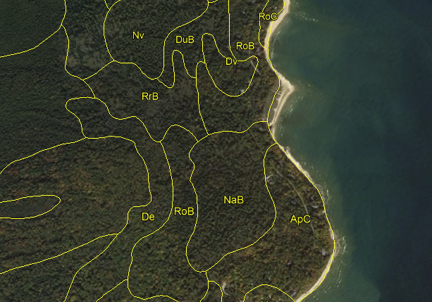
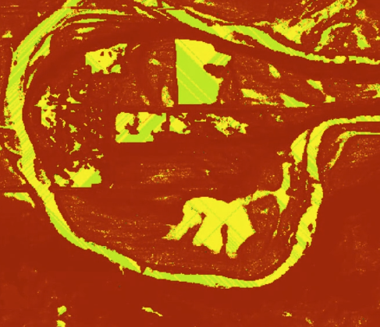
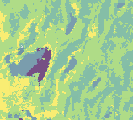


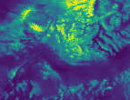
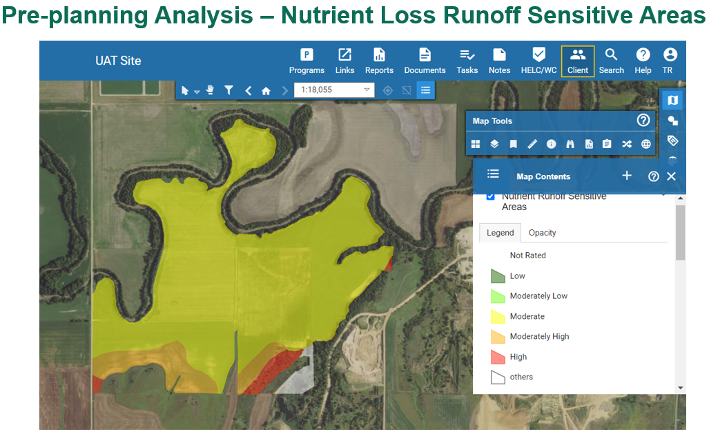
NRCS
Soil Data
Proximal/Remote Sensing Data
Aggregation
Additional soil
Rainfall Factor
Slope
Kw Factor
T Factor
Slope Length
Water Availability
Oxygen Availability
Nutrient Availability
Erosion Hazard
Nutrient Runoff Model
Suitability Classes
Notes:
This is the general process to build a model. Models that use maps are incredibly powerful in telling stories because they connect us to a place. Getting a good map with a story, is complex, the process takes a lot of work. Landscapes have many interconnected processes and changing conditions. Not every process or system is well-known, even after decades of research. With the climate crisis, we can look to technology and high-quality data to help us adapt solutions. NRCS is a geospatial organization and using a geospatial approach to technology. We can enable collaboration across disciplines and assist conservation planning and other land management decision tools. We can take in and store all kinds of data, manage it, analyze it, and make powerful maps with it. Maps mobilize people and decisions since they show location and give context. The conservation planner or producer can connect the map and the information and see what’s happening on the ground. With additional data layers like satellite imagery through AI and machine learning, we harness technology and train models to recognize conservation on the ground. This results in better, more informed decisions.

Slide 5
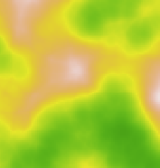
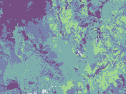
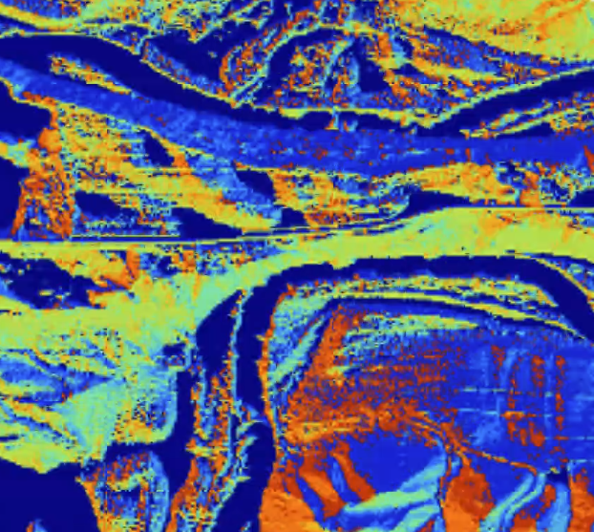

Various
Soil Data
Proximal/Remote Sensing Data
3 Meter Elevation
Aggregation
Derivatives
Additional soil
Stream Power Index
Slope Degrees
Soil Depth
Other Soil Properties
Soil Moisture
Near Real time Precipitation
Flow Direction
Slope Length
Water Availability
Oxygen Availability
Nutrient Availability
Erosion Hazard
Nutrient Runoff Model
Suitability Classes
Notes:
This is the general process to build a model. Models that use maps are incredibly powerful in telling stories because they connect us to a place. Getting a good map with a story, is complex, the process takes a lot of work. Landscapes have many interconnected processes and changing conditions. Not every process or system is well-known, even after decades of research. With the climate crisis, we can look to technology and high-quality data to help us adapt solutions. NRCS is a geospatial organization and using a geospatial approach to technology. We can enable collaboration across disciplines and assist conservation planning and other land management decision tools. We can take in and store all kinds of data, manage it, analyze it, and make powerful maps with it. Maps mobilize people and decisions since they show location and give context. The conservation planner or producer can connect the map and the information and see what’s happening on the ground. With additional data layers like satellite imagery through AI and machine learning, we harness technology and train models to recognize conservation on the ground. This results in better, more informed decisions.

Slide 6
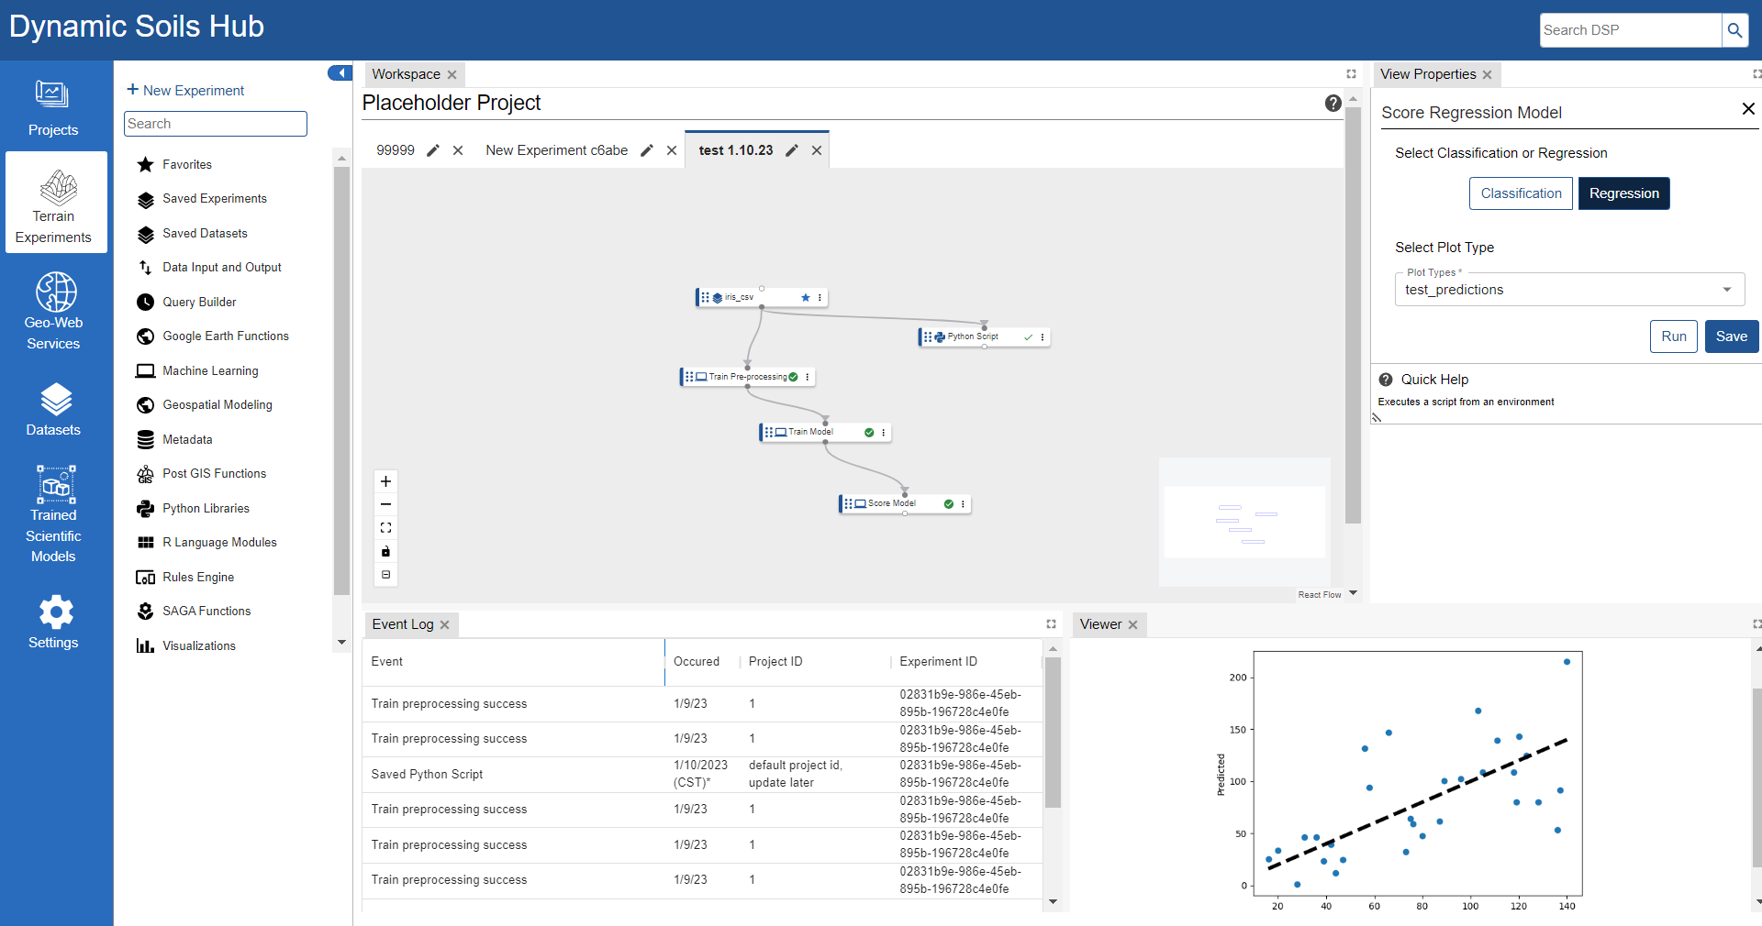

Notes:
The Dynamic Soils Hub is being built to help the soil scientists do this process faster and with high-resolution data. The detailed raw soil data can be combined with other high-resolution data like imagery and elevation data to create better models. Then, we can deploy them into the data system to connect to CD and CART for dynamic modeling.
To do this for big geospatial data, we needed the right tools that include high end geospatial capacity to improve our models. We will soon have a variety of tools at our disposal that enable us to tell stories about the landscape in great detail with new technology. The soil scientists typically spend countless hours preparing data and compiling research material to tell a story and organizing it to display it properly. Advanced visualization capabilities will really enhance our storytelling abilities and the speed at which we can deploy new models into the data system. The ability to present the raw facts and numbers with interactive visualizations has led to modern data storytelling/

Slide 7

#ThankYou
Notes:
Thanks so much.

Slide 9
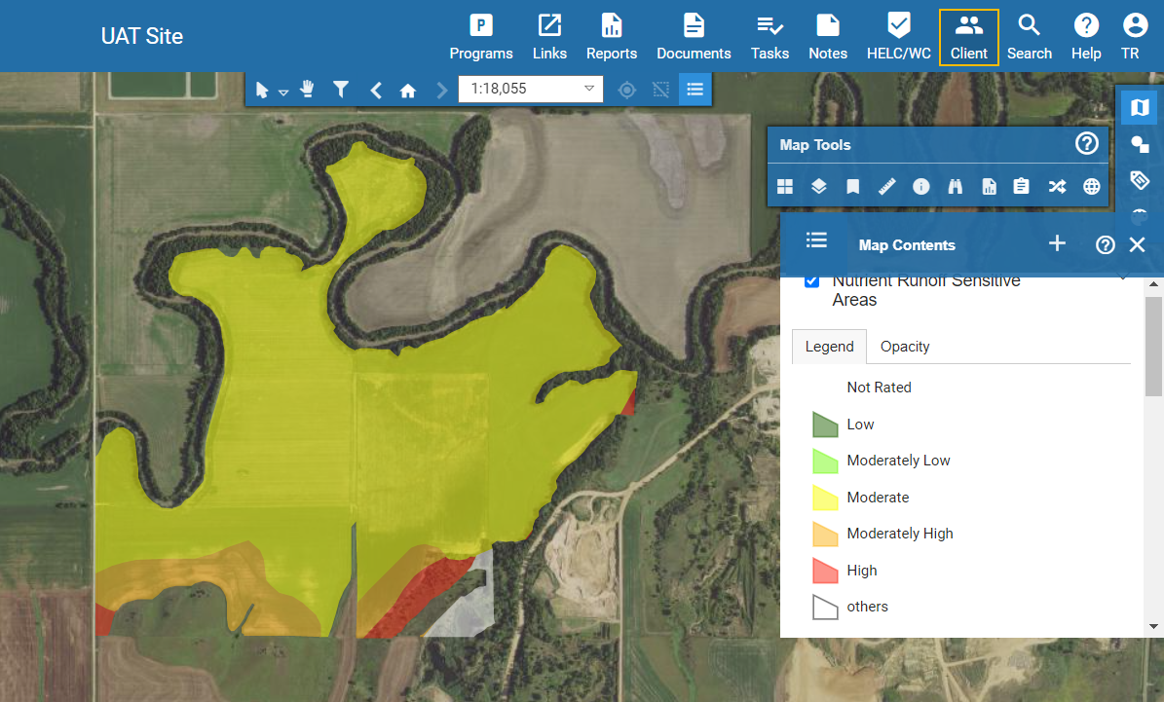
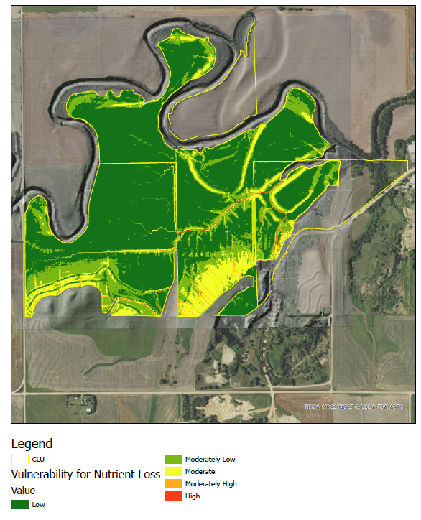
Planning Analysis – Nutrient Loss Runoff Sensitive Areas

